Slide 1
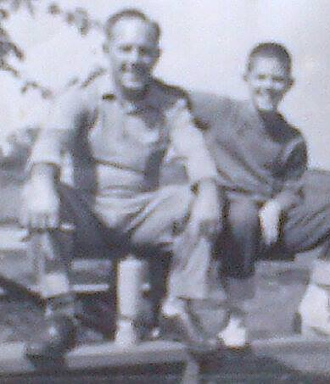
The
21 C’s
of
Father-hood

Slide 2
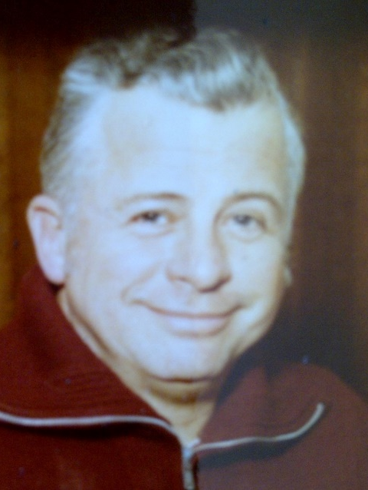
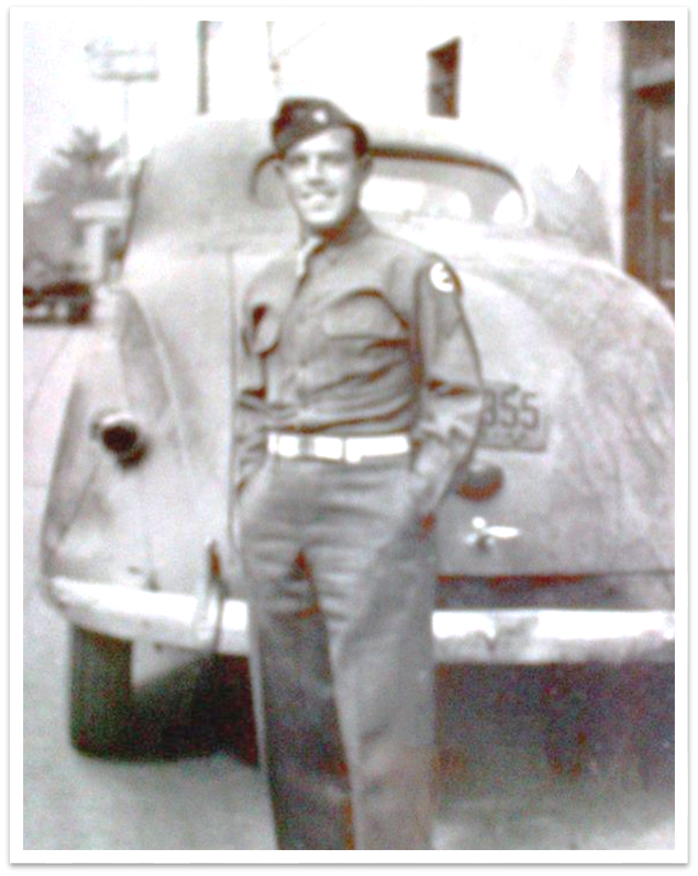
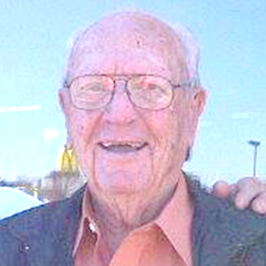
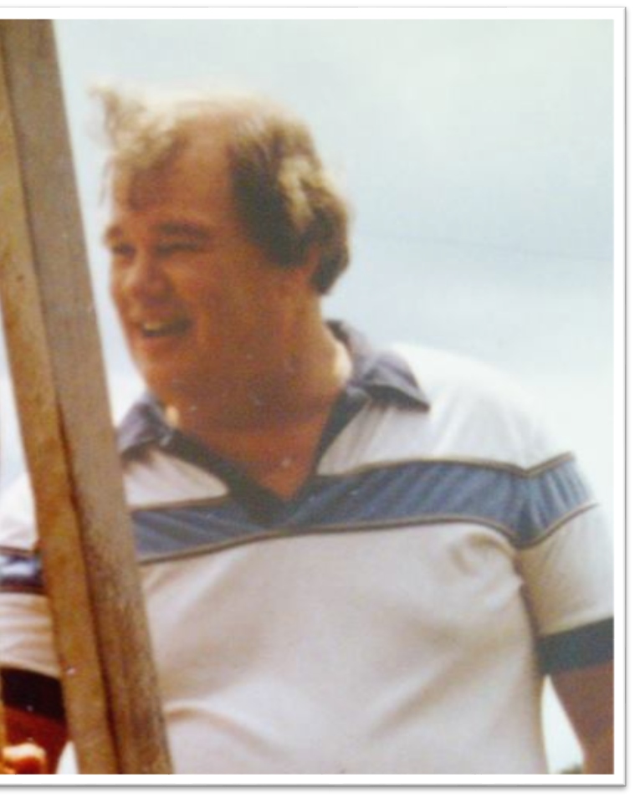
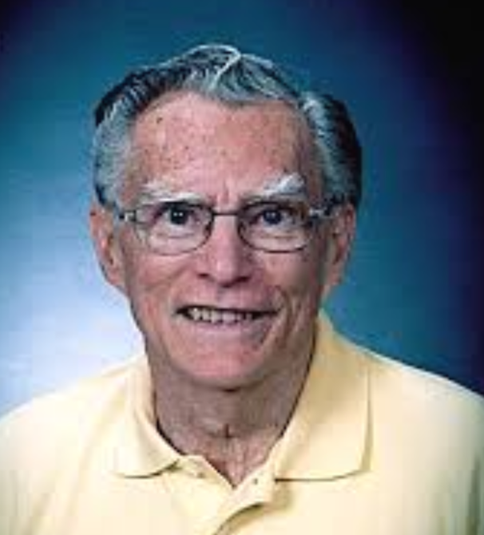
Harel Bennett
Bill Tulip
Don Baudrand
Charles Coggins
Buddy Harrison

Slide 3

Colossians 3:19 Husbands, love your wives [with an affectionate, sympathetic, selfless love that always seeks the best for them] and do not be embittered or resentful toward them [because of the responsibilities of marriage].

Slide 4

21 Fathers, do not provoke or irritate or exasperate your children [with demands that are trivial or unreasonable or humiliating or abusive; nor by favoritism or indifference; treat them tenderly with lovingkindness], so they will not lose heart and become discouraged or unmotivated [with their spirits broken].

Slide 5

CEO
You are the boss
2. COMPASS
you provide direction
3. COMMUNICATOR you keep your family informed and up to date

Slide 6
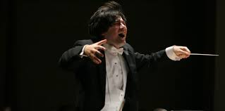
4. CREATOR
you invent things
5. COMPOSER
you are writing your life-song
6. CONDUCTOR
you are leading the orchestra

Slide 7

7. COACH
you train, encourage
and correct
8. COURAGEOUS
you face your fears
9. CHAMPION
you make your family
win

Slide 8

10. CLEVER
you figure out
what needs to be done
11. CAPABLE
your have the skills or
acquire the skills
to do the job well
12. CONTRIBUTOR
you provide the
resources for the families needs

Slide 9

13. CO-LABORER
you are working together
with God and your wife
14. CARE-GIVER
you help with the basic
human needs of your family
15. CLEAN-UP CREW
clean the dishes, sweep the floor, do the laundry, groom the yard, wash the car … !!!

Slide 10

16. COMPASSIONATE
you show empathy and tenderness
17. CUDDLER
you provide loving affirming touch to your family
18. COUNSELOR
you have a listening
ear and offer good
advice

Slide 11
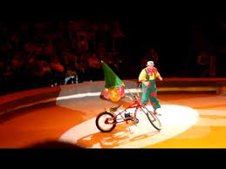
19. CHEERLEADER
you root for your children and wife you’re their biggest fan
20. COMEDIAN
you learn to laugh at yourself and find humor in life
21. CLOWN
you can be silly and goofy
to help diffuse life’s
pressures

Slide 12

22. THE ULTIMATE C IS TO BECOME
CHRIST-LIKE
My Confession
I am an imitator of God in everything I do. I am His son growing into full maturity as a man. I am living a life filled with love, following the example of Christ my Lord. Just as He loved me and offered himself as a sacrifice for me, I am willingly doing the same for my family and it is a sweet and pleasing aroma to my Father God.
Ephesians 5:1-2

