Slide 1
Musicians workshop
Colossians 3:16

Slide 2
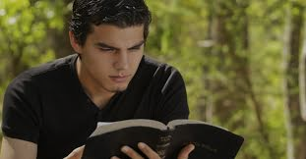
THE WORD OF CHRIST
Let the word of Christ dwell in you richly in all wisdom; teaching and admonishing one another in psalms and hymns and spiritual songs, singing with grace in your hearts to the Lord. Colossians 3:16

Slide 3
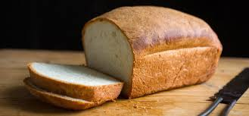
Matthew 4:4 But he answered and said, It is written, Man shall not live by bread alone, but by every word that proceedeth out of the mouth of God.

Slide 4
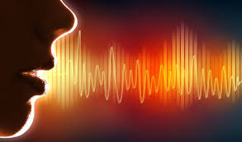
Matthew 8:8 The centurion answered and said, Lord, I am not worthy that thou shouldest come under my roof: but speak the word only, and my servant shall be healed.

Slide 5
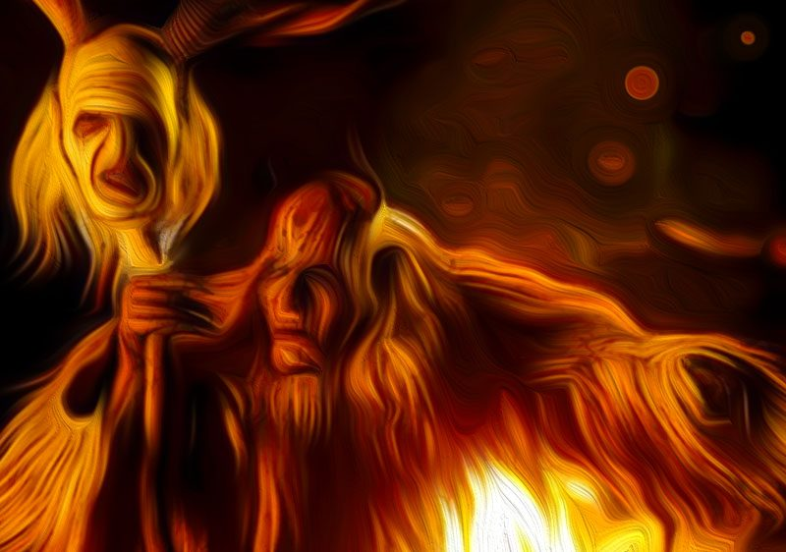
Matthew 8:16 When the even was come, they brought unto him many that were possessed with devils: and he cast out the spirits with his word, and healed all that were sick:

Slide 6
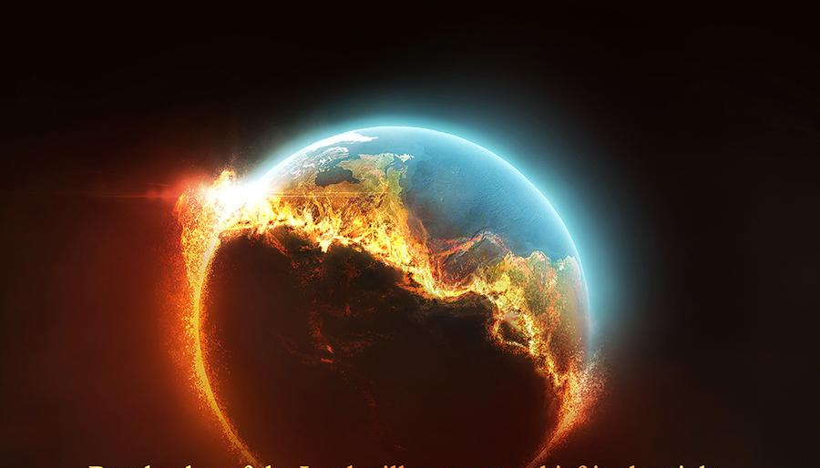
Mark 13:31 Heaven and earth shall pass away: but my words shall not pass away.

Slide 7
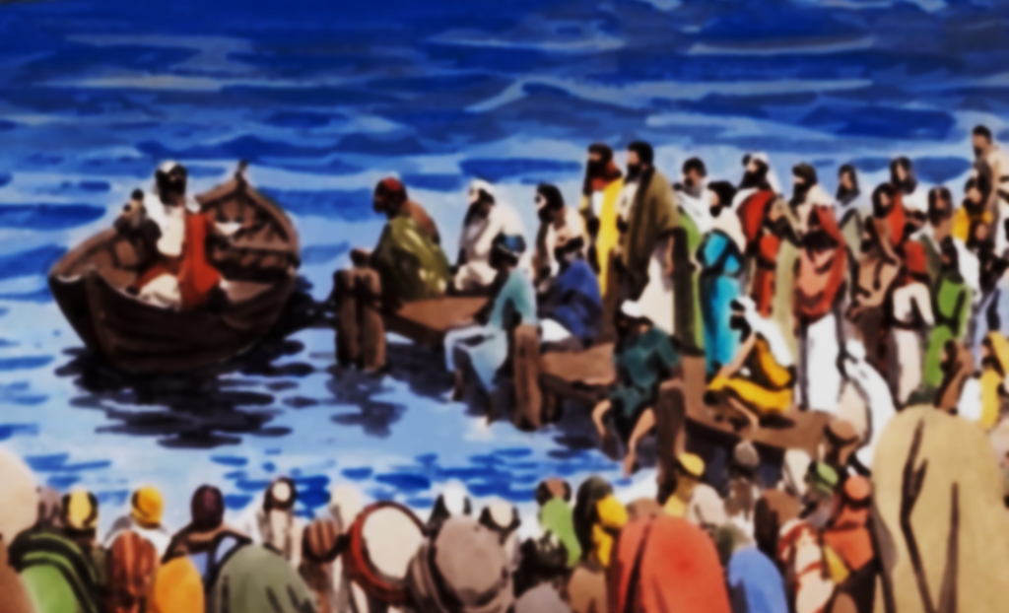
Luke 5:1 And it came to pass, that, as the people pressed upon him to hear the word of God

Slide 8
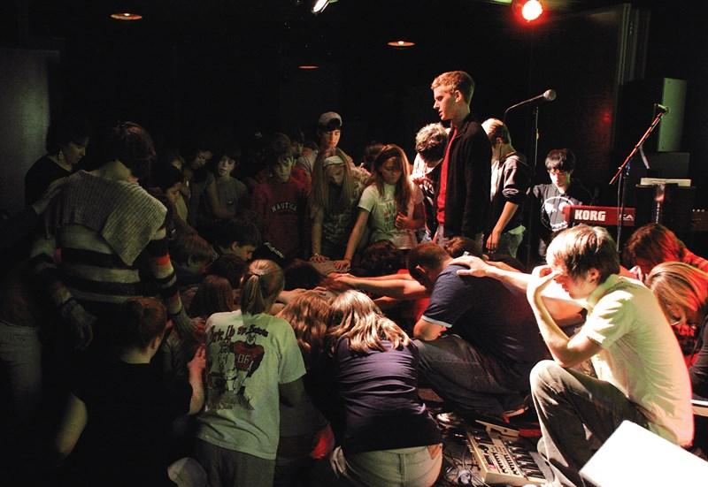
PRAYER TAPS INTO
HEAVENS SYMPHONY
1 Thessalonians 5:17
Pray without ceasing

Slide 9
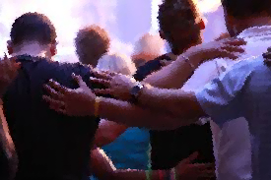
PRAYING ALWAYS WITH ALL PRAYER
Ephesians 6:18
Praying always with all prayer and supplication in the Spirit, and watching thereunto with all perseverance and supplication for all saints;

Slide 10
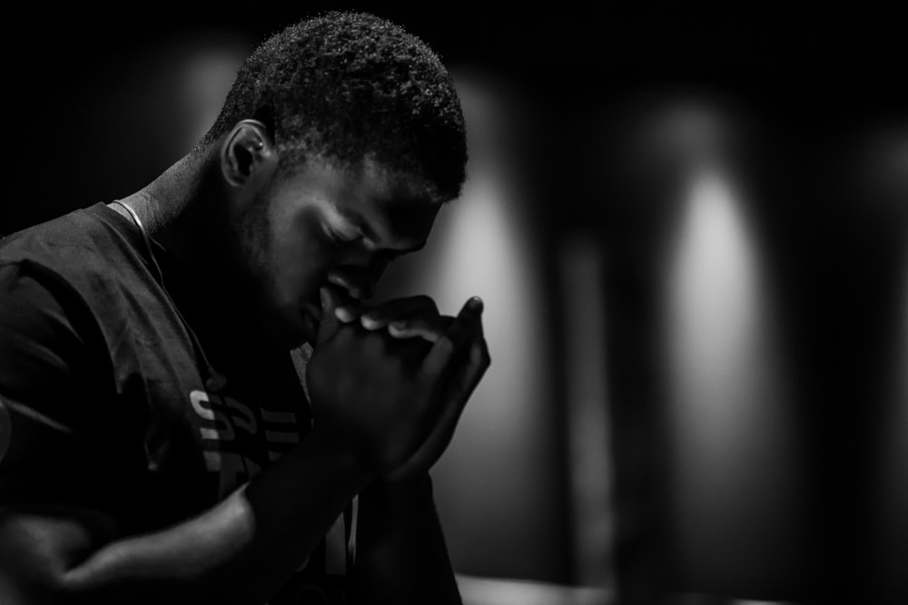
PRAYING IN THE HOLY GHOST
Jude 1:20
But ye, beloved, building up yourselves on your most holy faith, praying in the Holy Ghost,

Slide 11
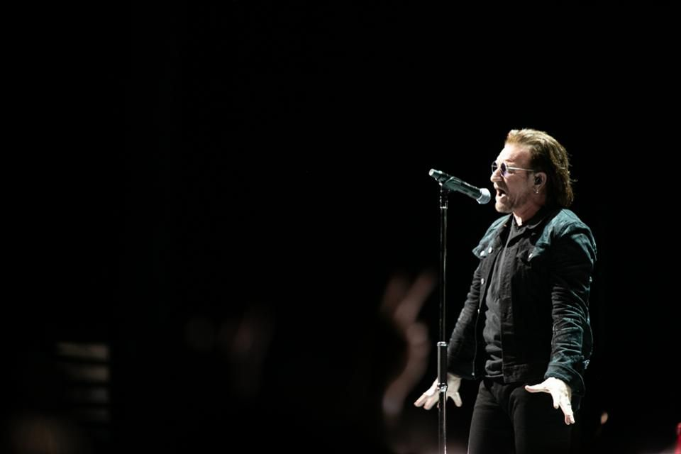
I WILL SING WITH THE SPIRIT
1 Corinthians 14:15
What is it then? I will pray with
the spirit, and I will pray with the understanding also: I will sing
with the spirit, and I will sing
with the understanding
also.

Slide 12
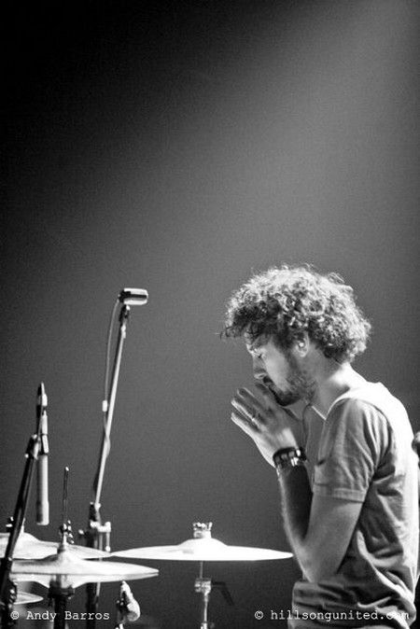
YOUR PRAYERS―THE INCENSE OF GOD
And when He had taken the scroll, the four living creatures and the twenty-four elders fell down before the Lamb (Christ), each one holding a harp and golden bowls full of fragrant incense, which are the prayers of the saints (God’s people). Revelation 5:8 AMP

Slide 13
TEACHING &
ADMONISHING
“teaching and admonishing one another in psalms and hymns and spiritual songs”

Slide 14
teach- to impart or cause to know something or do something, to instruct by precept or example, to teach students to think for themselves

Slide 15
admonish-to give friendly earnest advice, to cause to know the consequences of some action, to say something as a warning.

Slide 16
AUDIENCE OF ONE
“singing with grace
in your hearts to
the Lord”

Slide 17
GOOD GIFTS
Every good gift and every perfect gift is from above, and cometh down from the Father of lights, with whom is no variableness, neither shadow of turning. James 1:17

Slide 18
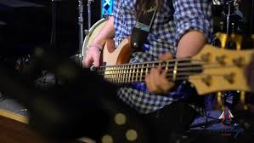
MINISTERS OF HIS GRACE
1 Peter 4:10 As each one has received a gift, minister it to one another, as good stewards of the manifold grace of God.

Slide 19
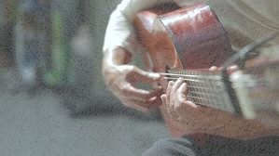
PLAY SKILFULLY
Psalm 33:1-3 Rejoice in the Lord, O ye righteous: for praise is comely for the upright. Praise the Lord with harp: sing unto him with the psaltery and an instrument of ten strings. Sing unto him a new song; play skilfully with a loud noise.

Slide 20
THE ANOINTING
Hebrews 1:9
Thou hast loved righteousness, and hated iniquity; therefore God, even thy God, hath anointed thee with the oil of gladness above thy fellows.

Slide 21
THE LORD THY GOD IN THE MIDST OF THEE
The Lord thy God in the midst of thee is mighty; he will save, he will rejoice over thee with joy; he will rest in his love, he will joy over thee with singing.
Zephaniah 3:17

Slide 22
I WOULD HAVE DESPAIRED
I would have despaired unless I had believed to see the goodness of the Lord.
In the land of the living.
In the land of the living.
In the land of the living of the Lord.
Psalm 27:13 NASB

Slide 23
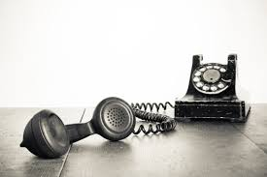
I WILL CALL UPON THE LORD
I will call upon the Lord, who is worthy to be
praised: so shall I be saved from mine enemies.
The Lord liveth; and blessed be my
rock; and let the God of my
salvation be exalted.
Psalm 18:3, 46

Slide 24
HOW LOVELY ARE THY DWELLING PLACES
How lovely are Thy dwelling places, My soul longs for the courts of the Lord;
My heart and my flesh sing for joy to the living God. You are my King and my God.
Psalms 84:1-3

Slide 25
PRAISE
But thou art holy, O thou that inhabits the praises of Israel.
Psalm 22:3

Slide 26
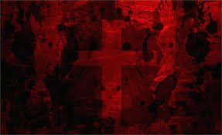
PRAISE GOD AT ALL TIMES
PRAISE AS A POINT OF ENTRY
PRAISE FROM THE HEART
PRAISE AS A SACRIFICE OR OFFERING
PRAISE AS A WEAPON OR A DEFENSE
PRAISE AS A WITNESS

Slide 27
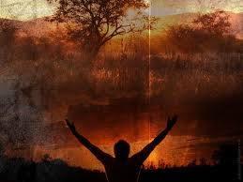
PRAISE GOD AT ALL TIMES
Psalm 34:1 I will bless the Lord at all times: his praise shall continually be in my mouth. 2 My soul shall make her boast in the Lord: the humble shall hear thereof, and be glad. 3 O magnify the Lord with me, and let us exalt his name together. 4 I sought the Lord, and he heard me, and delivered me from all my fears.

Slide 28
PRAISE AS A POINT OF ENTRY
Psalm 100:4 Enter into his gates with thanksgiving, and into his courts with praise: be thankful unto him, and bless his name.

Slide 29
PRAISE FROM THE HEART
Psalm 86:12 I will praise thee, O Lord my God, with all my heart: and I will glorify thy name for evermore.

Slide 30
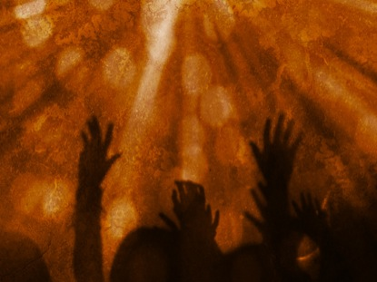
PRAISE AS A SACRIFICE
OR OFFERING
Hebrews 13:15 By him therefore let us offer the sacrifice of praise to God continually, that is, the fruit of our lips giving thanks to his name.

Slide 31
PRAISE AS A WEAPON OR
A DEFENSE
2 Samuel 22:2 The Lord is my rock, and my fortress, and my deliverer; 3 The God of my rock; in him will I trust: he is my shield, and the horn of my salvation, my high tower, and my refuge, my saviour; thou savest me from violence. 4 I will call on the Lord, who is worthy to be praised: so shall I be saved from mine enemies.

Slide 32
PRAISE AS A WITNESS
Psalm 108:3 I will praise thee, O Lord, among the people: and I will sing praises unto thee among the nations.

