Slide 1
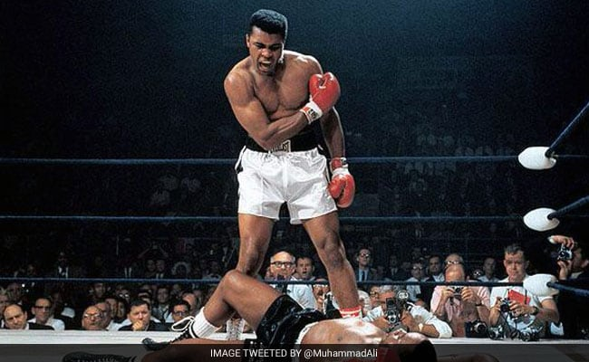
ARE YOU A CONTENDER?
Jude 3:3

Slide 2
Beloved, when I gave all diligence to write unto you of the common salvation, it was needful for me to write unto you, and exhort you that ye should earnestly contend for the faith which was once delivered unto the saints.
Jude 3:3

Slide 3
If thou hast run with the footmen, and they have wearied thee, then how canst thou contend with horses? and if in the land of peace, wherein thou trustedst, they wearied thee, then how wilt thou do in the swelling of Jordan? Jeremiah 12:5

Slide 4
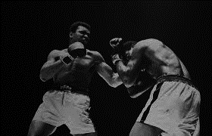
To struggle with an opposing force, to strive in competition, to train for battle, fight to the finish
WE CONTEND

Slide 5
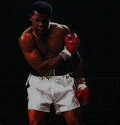
Colossians 1:28 So we tell others
about Christ, warning everyone
and teaching everyone with all the
wisdom God has given us. We want
to present them to God, perfect in
their relationship to Christ. That’s
Why I work and struggle so hard,
depending on Christ’s mighty
power that works
within me.
WE STRUGGLE

Slide 6
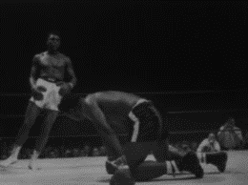
Strive to enter through the narrow gate, for many, I say to you, will seek to enter and will not be able. Luke 13:24
Yea, so have I strived to preach the gospel, where Christ was not known, so that I would not be building on someone else’s foundation. Romans 15:20
WE STRIVE

Slide 7
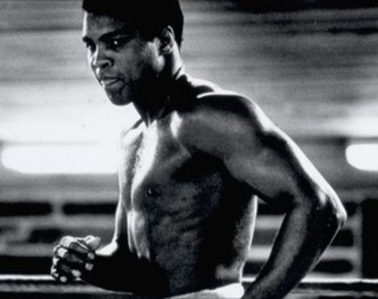
“I hated every minute of training, but like I said, don’t quit. Suffer now and live the rest of your life as a champion.”
─Mohammad Ali
WE TRAIN

Slide 8
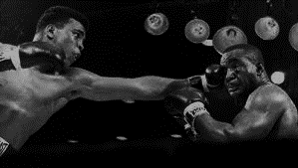
No discipline is enjoyable while
it is happening
— it’s painful!
But afterward
there will be a
peaceful harvest of right living for those
who are trained in this way. Hebrews 12:11
WE DISCIPLINE

Slide 9
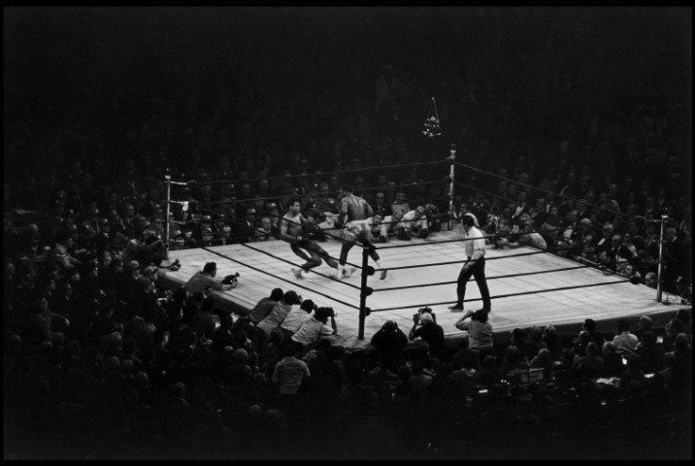
Therefore, since we are surrounded by such a huge crowd of witnesses to the
life of faith, let us strip
off every weight that
slows us down, especially
the sin that so easily trips us up. And let us run with endurance the race God has set before us. Hebrews 12:1
WE ENDURE

Slide 10
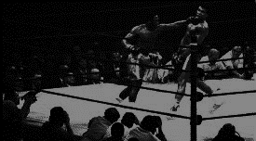
Hebrews 11:32 Who through faith subdued kingdoms, wrought righteousness, obtained promises, stopped the mouths of lions. Quenched the violence of fire, escaped the edge of the sword, out of weakness were made strong, waxed valiant in fight, turned to flight the
armies of the aliens.
WE FIGHT

Slide 11
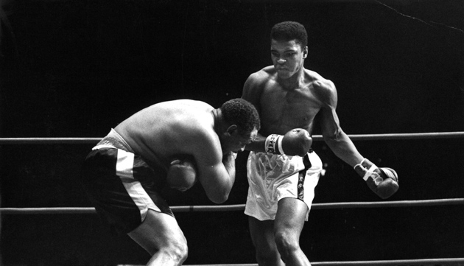
1 Timothy 6:12 Fight the good fight for the true faith. Hold tightly
to the eternal life to
which God has called
you, which you have
declared so well
before many
witnesses.
WE HOLD TIGHT

Slide 12
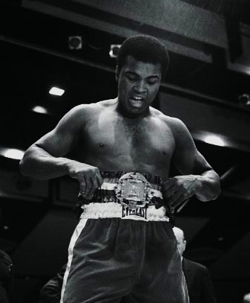
1 Corinthians 9:24 Know ye not that they which run in a race run all, but one receiveth
the prize? So run, that ye may obtain.
WE OBTAIN

Slide 13
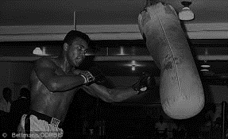
Titus 3:8 This is a faithful saying, and these things I will that thou affirm constantly, that they which have believed in God might be
careful to maintain
good works. These
things are good
and profitable
unto men.
WE MAINTAIN

Slide 14
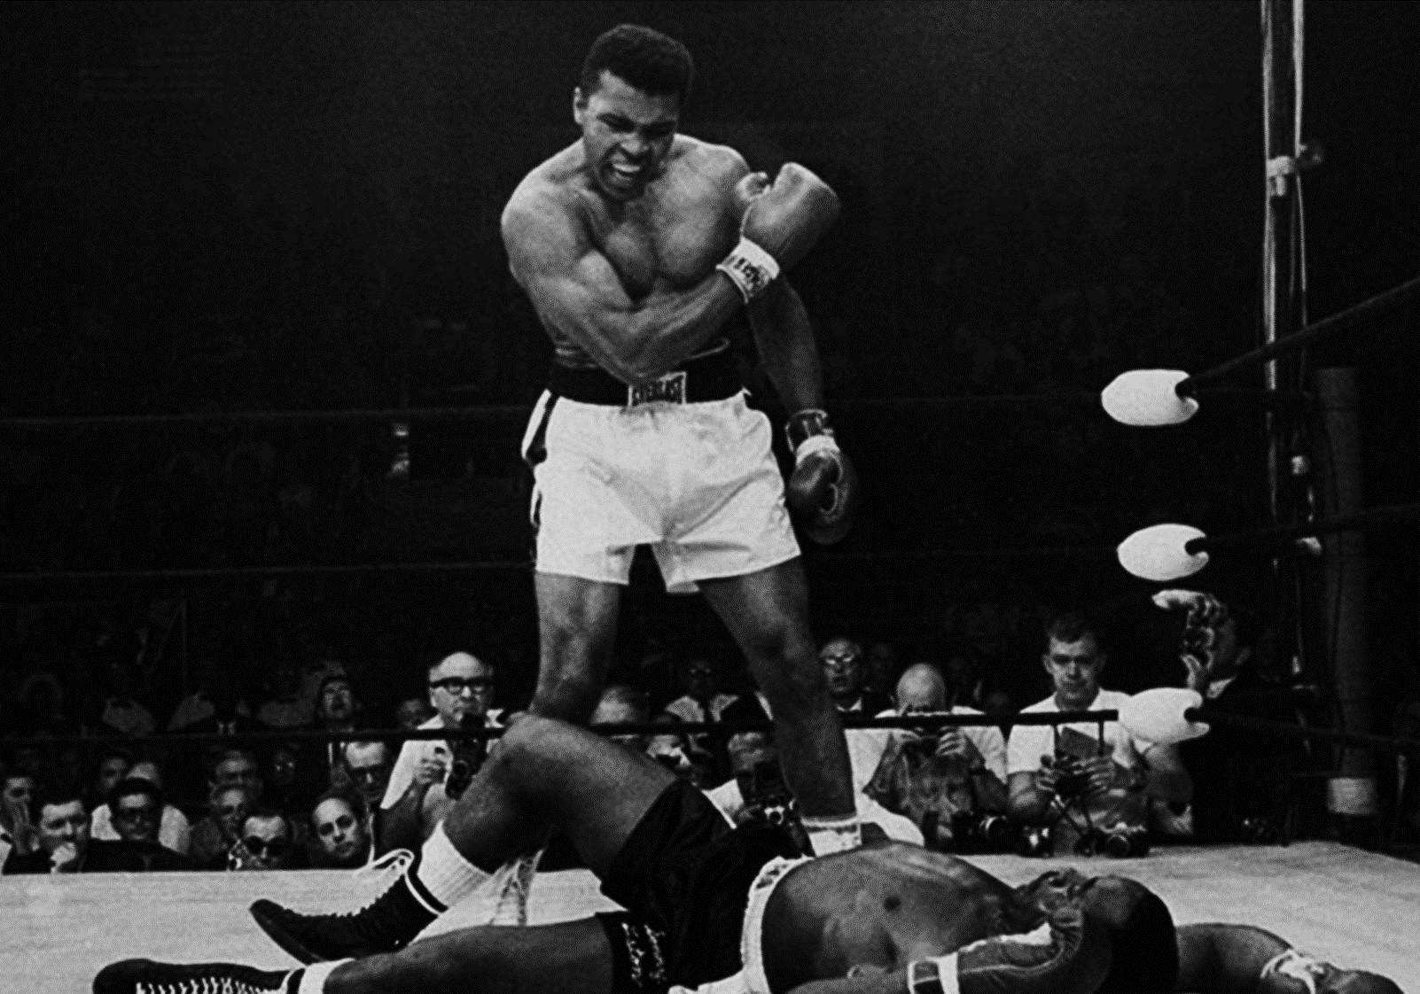
2 Timothy 4:7-8 I have fought the good fight, I have finished the race, and I have remained faithful. And now the prize awaits me—the crown of righteousness, which the Lord, the righteous Judge,
will give me on the day
of his return.
WE FINISH

Slide 15
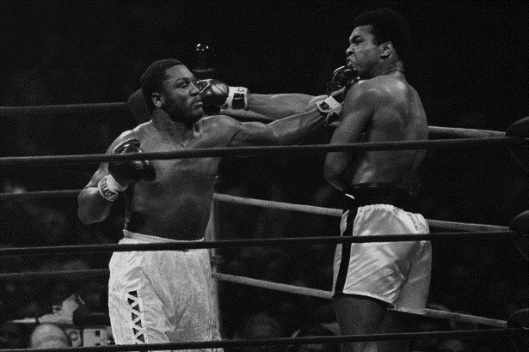
THE MAN IN THE ARENA
It is not the critic who counts; not the man who points out how the strong man stumbles, or where the doer of deeds could have done them better. The credit belongs to the man who is actually in the arena, whose face is marred by dust and sweat and blood—

Slide 16
who strives valiantly; who errs, who comes short again and again, because there is no effort without error and shortcoming; but who does actually strive to do the deeds; who knows great enthusiasms, the great devotions; who spends himself in a worthy cause; who at the best knows in the end the triumph of high achievement, and who at the worst, if he fails, at least fails while daring greatly, so that his place shall never be with those cold and timid souls who neither know victory nor defeat. ―Theodore Roosevelt

Slide 17
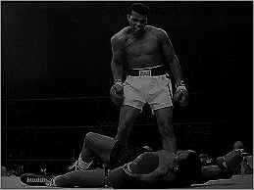
WE CONTEND
WE STRUGGLE
WE STRIVE
WE TRAIN
WE FIGHT
WE HOLD TIGHT
WE OBTAIN
WE MAINTAIN
WE FINISH

